Slide 1
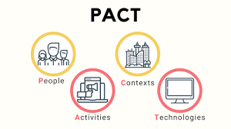
PACT FRAMEWORK
Ms. Iqra Shahzad
Department of Software Engineering, NUML, Islamabad.

Slide 2
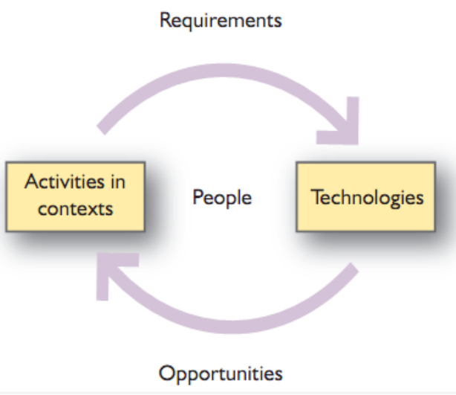
Introduction
In the fast-paced world of user interface (UI) design, it is crucial to understand the interplay between people, activities, context, and technologies.
These elements form the basis of the PACT framework, a powerful tool for analyzing and optimizing UI design.

Slide 3
Importance
PACT framework and its relationships can significantly enhance your ability to create intuitive and user-friendly interfaces.
The PACT framework serves as a fundamental guide for UI designers in comprehending the users’ needs, behaviours, and environment.
By focusing on the four main components of PACT — People, Activities, Context, and Technologies — designers can create interfaces that cater specifically to the target audience, ultimately resulting in enhanced user experiences.

Slide 4
People
Understanding the users is at the core of effective UI design.
Recognizing their demographics, goals, motivations, and preferences enables designers to tailor interfaces to their specific needs.
Physical differences
Height and weight
Variability in the five senses
Ergonomics
Ergonomics is the process of designing or arranging workplaces, products and systems so that they fit the people who use them.
Fitts’ law
Fitts's law is a predictive model of human movement primarily used in human–computer interaction and ergonomics. Fitts' law refers to the amount of time required for a person to move to target object or area.

Slide 5


Ergonomics
Ergonomics is the process of designing or arranging workplaces, products and systems so that they fit the people who use them.

Slide 6
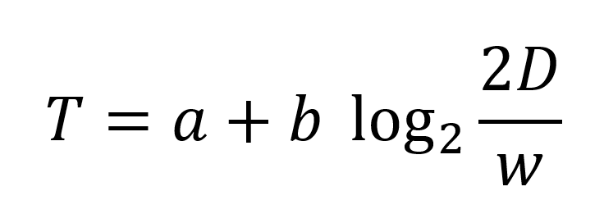
Fits law
Fitts’ law states that the amount of time required for a person to move a pointer (e.g., mouse cursor) to a target area is a function of the distance to the target divided by the size of the target. Thus, the longer the distance and the smaller the target’s size, the longer it takes.
The movement time to a target depends on the size of the target and the distance to the target.
The mathematical formula behind Fitts' law is

Slide 7
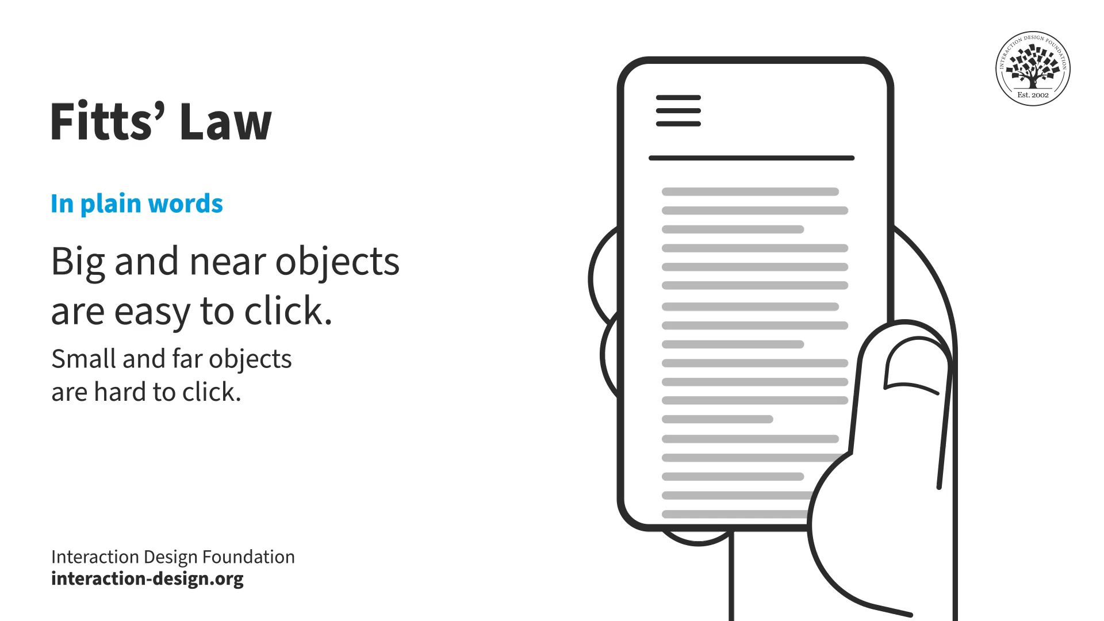

Slide 8
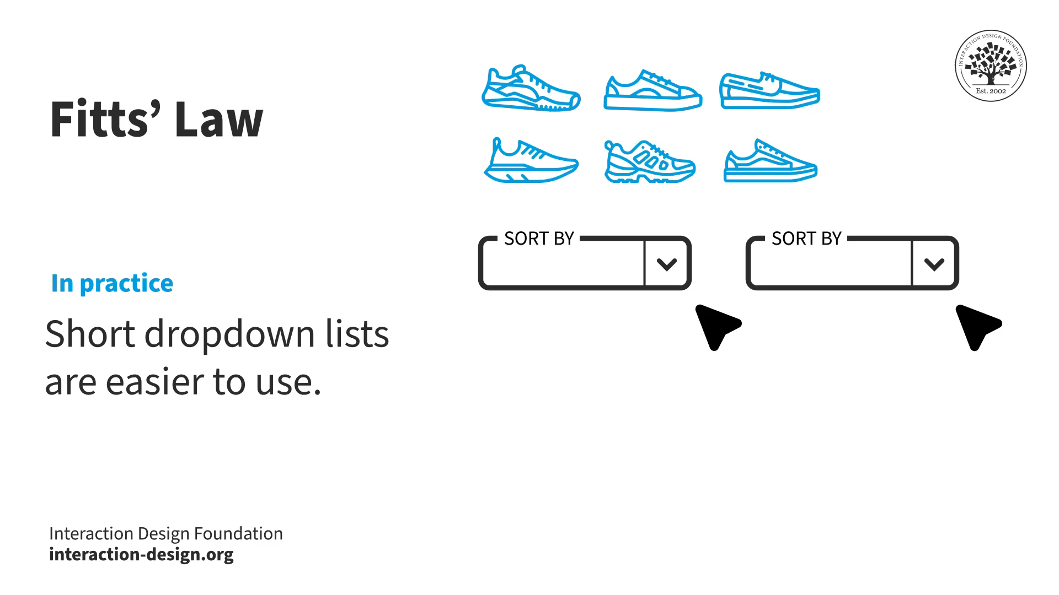
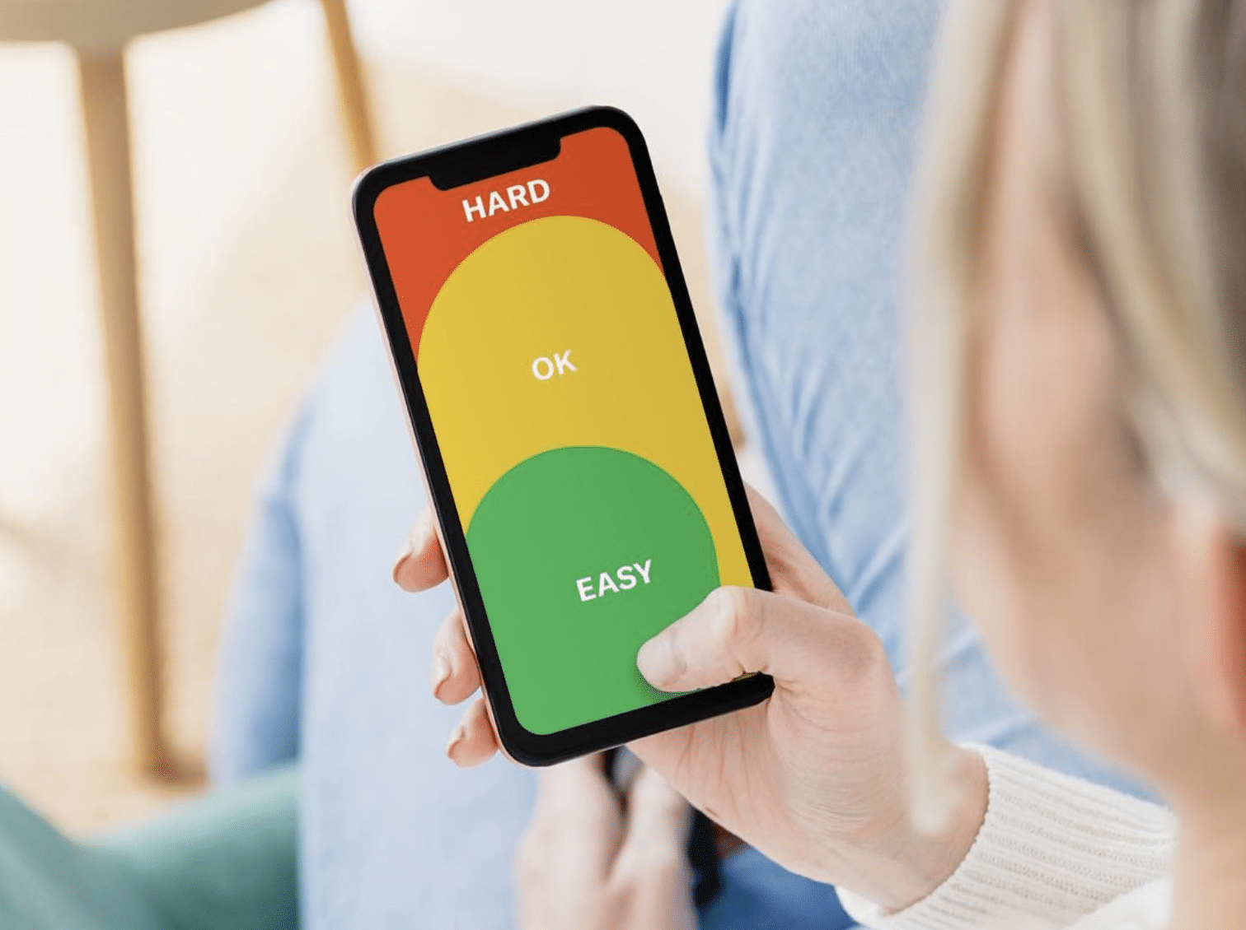

Slide 9
Psychological differences
Variety of ways e.g. spatial ability
Language and cultural differences (✓or ×)
Individual differences
Mental models

Slide 10
Mental model
People develop mental models through
interacting with systems
observing the relationship between their actions and the behaviors of the system
reading any manuals or other forms of explanation that come with a system.
So, it is important that designers provide sufficient information in the interface (and any accompanying documentation) for people to form an accurate mental mode

Slide 11
Designers have their own conception
It may differ from the actual system
System size and number of designers
System reveals the designer’s conception
Users have their own conception
interact with the system image
A clear, logical and consistent conceptual design is needed for Easy to communicate to users.

Slide 12
Social Differences
Different reasons/goals/motivations of system usage \
Time dependent
Novice and expert users
Attitudinal Differences
Self-pride, personal goal, global issues

Slide 13
Activities
In order to design interfaces that facilitate desired user interactions, designers must analyze the activities performed by users within the system.
By identifying the tasks, workflows, and processes users engage in, designers can streamline the interface, making it efficient and seamless.
This analysis helps in identifying potential bottlenecks and areas for improvement, ultimately enhancing user productivity and satisfaction.

Slide 14
Activities
Simple to very complex tasks
Main purpose of the task
Temporal aspects
Frequency of the task
Easy to do VS easy to learn
Time pressure
Interruption during the task
Response time
100 milliseconds for hand–eye coordination activities
01 second for a cause–effect relationship
Anything more than 5 seconds causes frustration

Slide 15
Cooperation
Individual VS group task
Awareness, communication, and coordination
Complexity
Well-defined VS vague task
Safety-critical
Serious consequences
Error handling
Nature of content
Text VS video data
Media

Slide 16
Context
The context in which users interact with an interface plays a crucial role in shaping their experiences.
Factors such as the user’s environment, time constraints, device capabilities, and cultural considerations heavily influence interface design decisions.
By comprehending the contextual factors, designers can create interfaces that are adaptable, responsive, and contextually relevant, leading to a more engaging user experience.

Slide 17
Activities always have some context ◻ Surrounding VS multiple activities
Physical environment
Light, noise etc
Social context
Social norms
Organizational context
Power/authority

Slide 18
Technologies
Technologies form the backbone of any UI design. Evaluating and leveraging appropriate technologies ensures that the interface is compatible, reliable, and efficient. Keeping up with the latest advancements in UI design tools and technologies allows designers to leverage their full potential, resulting in interfaces that are aesthetically pleasing, responsive, and technologically robust.

Slide 19
Hardware and software
Large variety of devices
Processing cycle
Input Buttons – direct method
Mobile phones?
‘QWERTY’ keyboard – 1868
Single touch VS multi touch
Remote pointing
Different sensors

